Slide 1
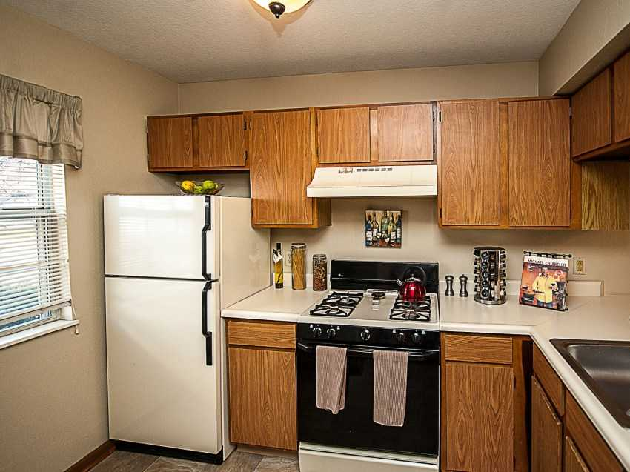
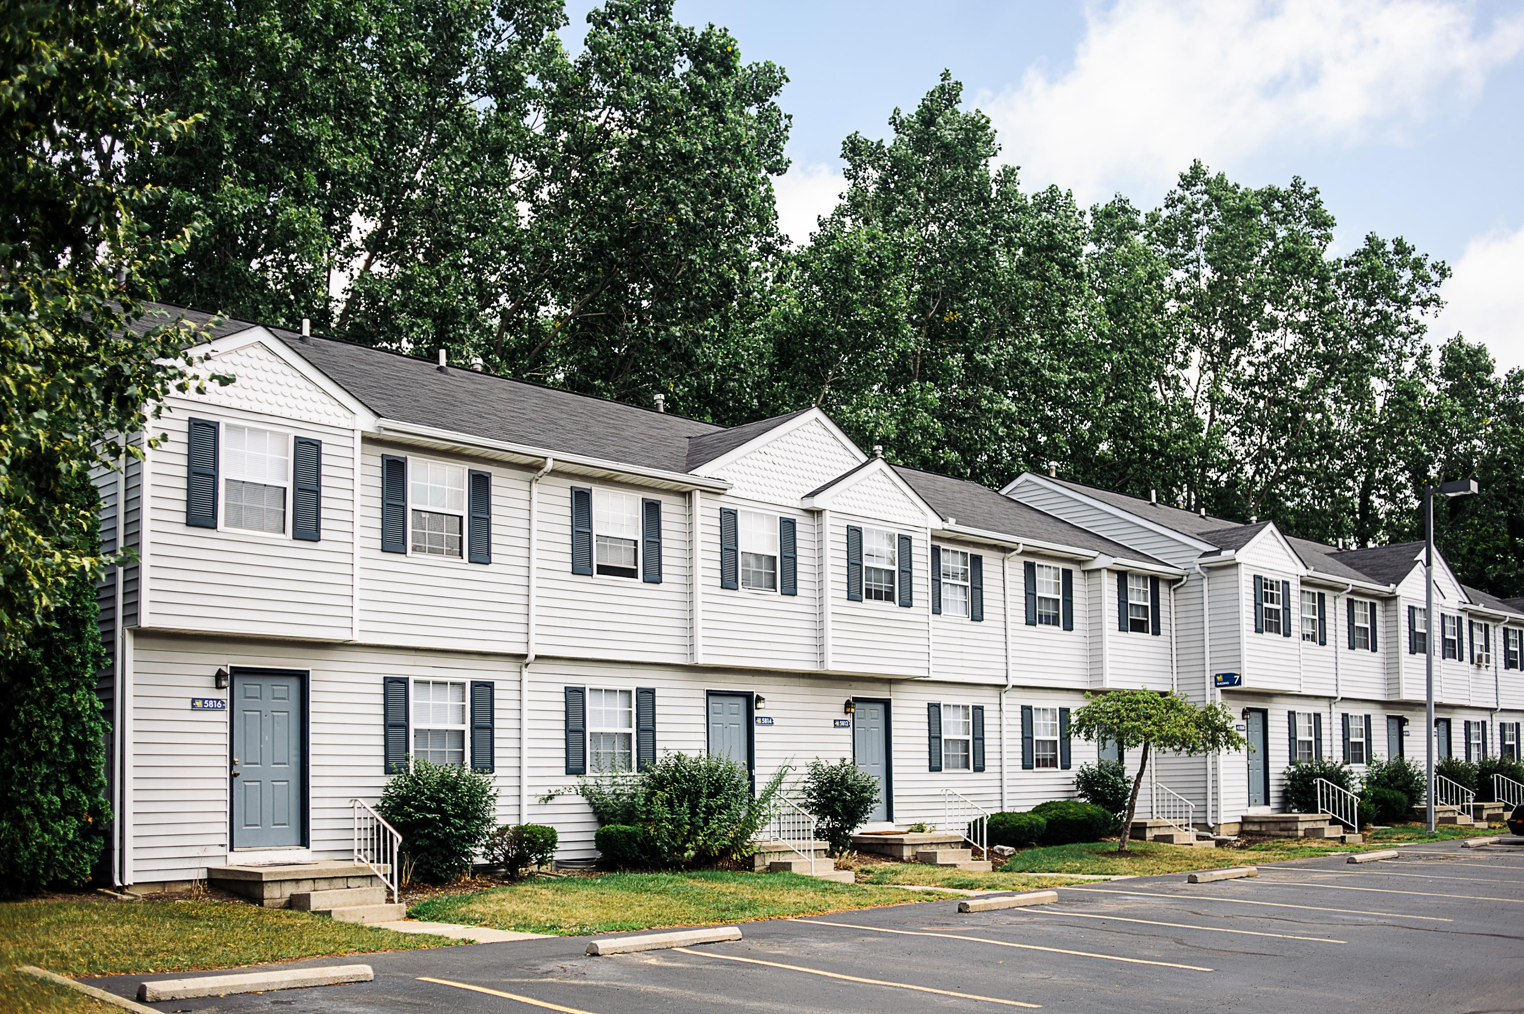
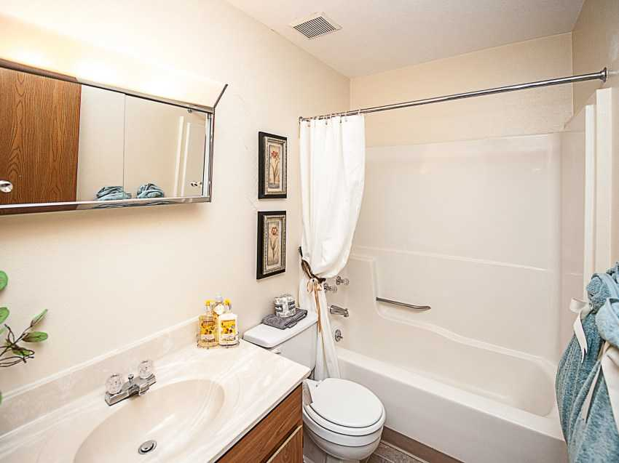
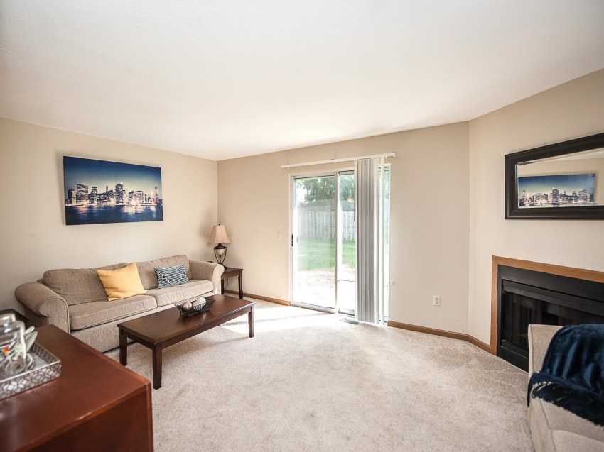
Shady Haven Apartments
506 Units | Stabilized Multifamily Community
Toledo, Ohio 43615

Slide 2
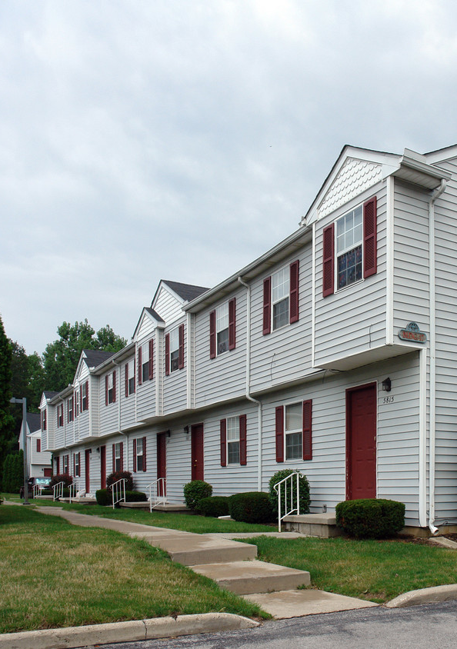
Shady Haven – Property Overview
Shady Haven Apartments is a 506-unit apartment community located in the Toledo, OH MSA. The property is ideally located one-third of a mile from Interstate 475 (I-475) and about eight miles from downtown Toledo. Sitting on over 45 acres of manicured landscape, the community offers residents a host of amenities and enjoys a prime location with easy access to downtown and nearby retail and dining.
The property was constructed in phases starting in 1988 and is made up of two-story buildings constructed of brick and vinyl siding that encompass 549,610 rentable square feet. The well-appointed community offers several unique floor plans averaging 1,086 square feet and includes a favorable mix of one, two and three bedroom units, including townhomes with attached two car garages. The spacious floor plans and apartment homes ranging in size from 932 to 1,350 square feet are well suited to students, young professionals and working families. Residents have access to a variety of amenities including a clubhouse, fitness center, tennis courts, and a business center.
Information presented in this offering comes from sources believed to be reliable, however, we make no representations or
warranties, expressed or implied, as to its accuracy. Buyer should verify the information and bears all risk for any inaccuracies.

Slide 3
Shady Haven – Unit Mix
Unit Mix Includes 2 and 3 Bedroom Apartment Homes
Information presented in this offering comes from sources believed to be reliable, however, we make no representations or
warranties, expressed or implied, as to its accuracy. Buyer should verify the information and bears all risk for any inaccuracies.

Slide 4
Community Estates| 492 Units | Fairfield, Ohio (Cincinnati MSA)

Slide 5
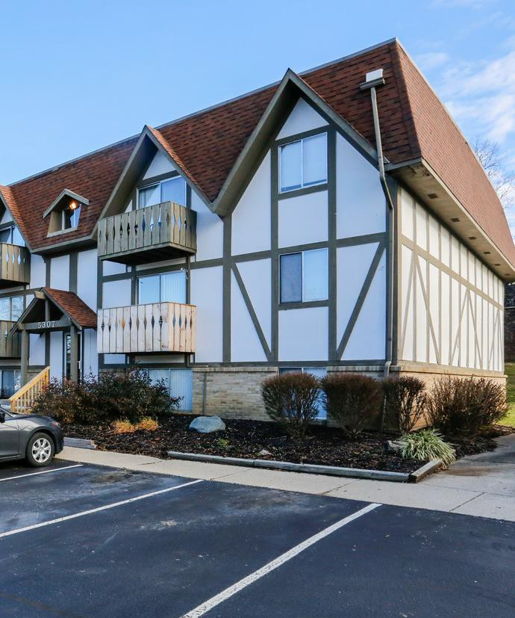
Property Description
Community Estates is a 492-unit apartment community located in the city of Fairfield, Ohio. The first phase of the community was built in 1970 and consists of 322 apartments. Phase II of Camelot East has 170 units and was completed in 1973. The property occupies 30.8 acres. This community consists of 53 two-, two-and-a-half, and three-story wood frame / brick-constructed buildings with mansard shingle roofs. The apartment community has 400,874 square feet of rentable space.
Community Estates is landscaped with lush grass and mature trees. The average unit size is 815 square feet.
Community amenities include a clubhouse, business center, laundry room, creativity lounge with free Wi-Fi, fitness center, indoor spa, barbecue and picnic area, two outdoor swimming pools, volleyball court, tennis court, and playground. Unit amenities at Community Estates include:
Fully equipped kitchen with refrigerator, stove, dishwasher, and disposal
Vaulted ceilings and oversized closets, and wood plank flooring
Washer and dryer connection in select units
Electric heating, air conditioning, fireplace, and ceiling fans
Private patio or balcony

Slide 7
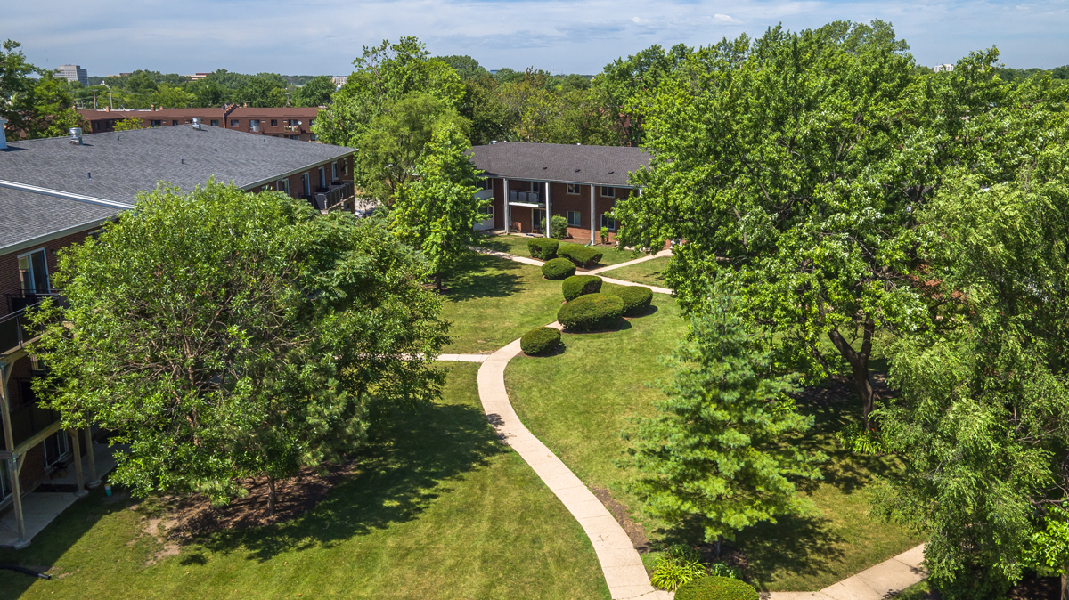
Metro Park Gardens | 344 Units | Mount Prospect, Illinois

Slide 8
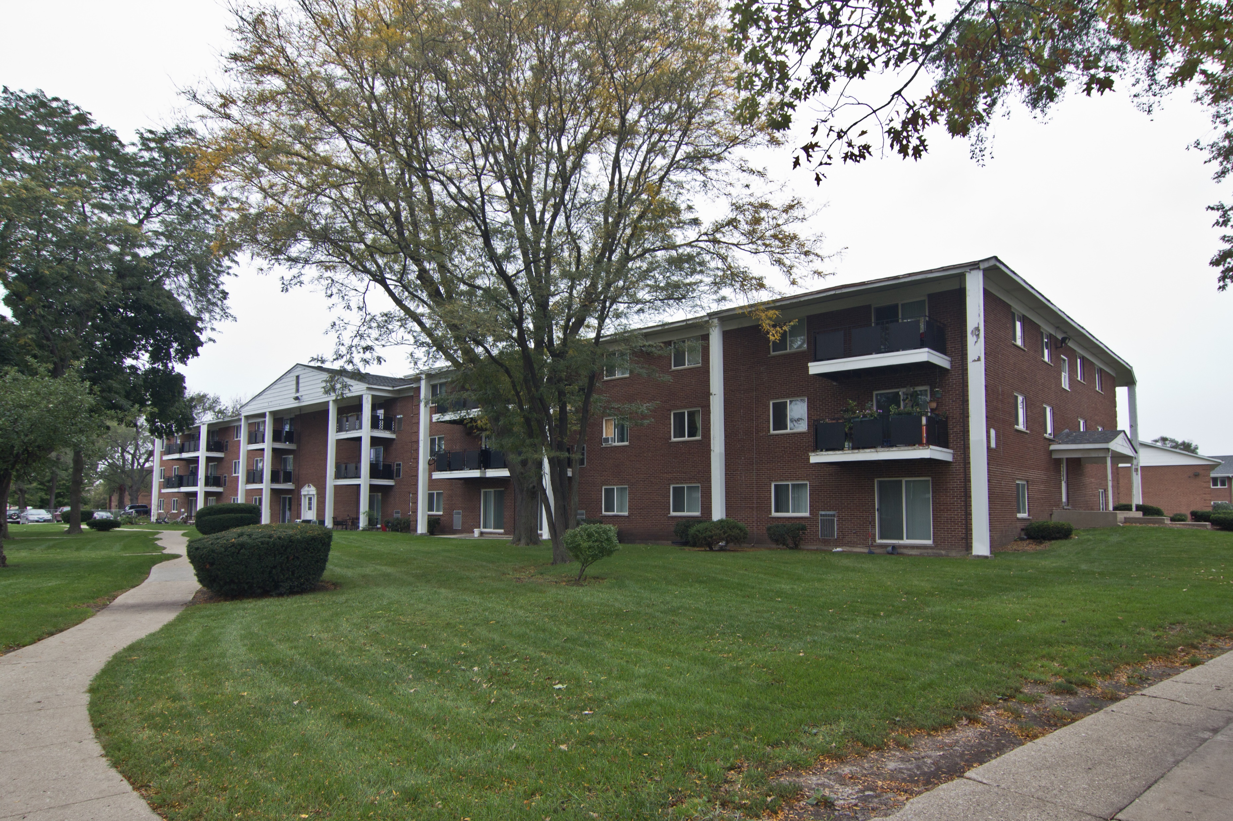
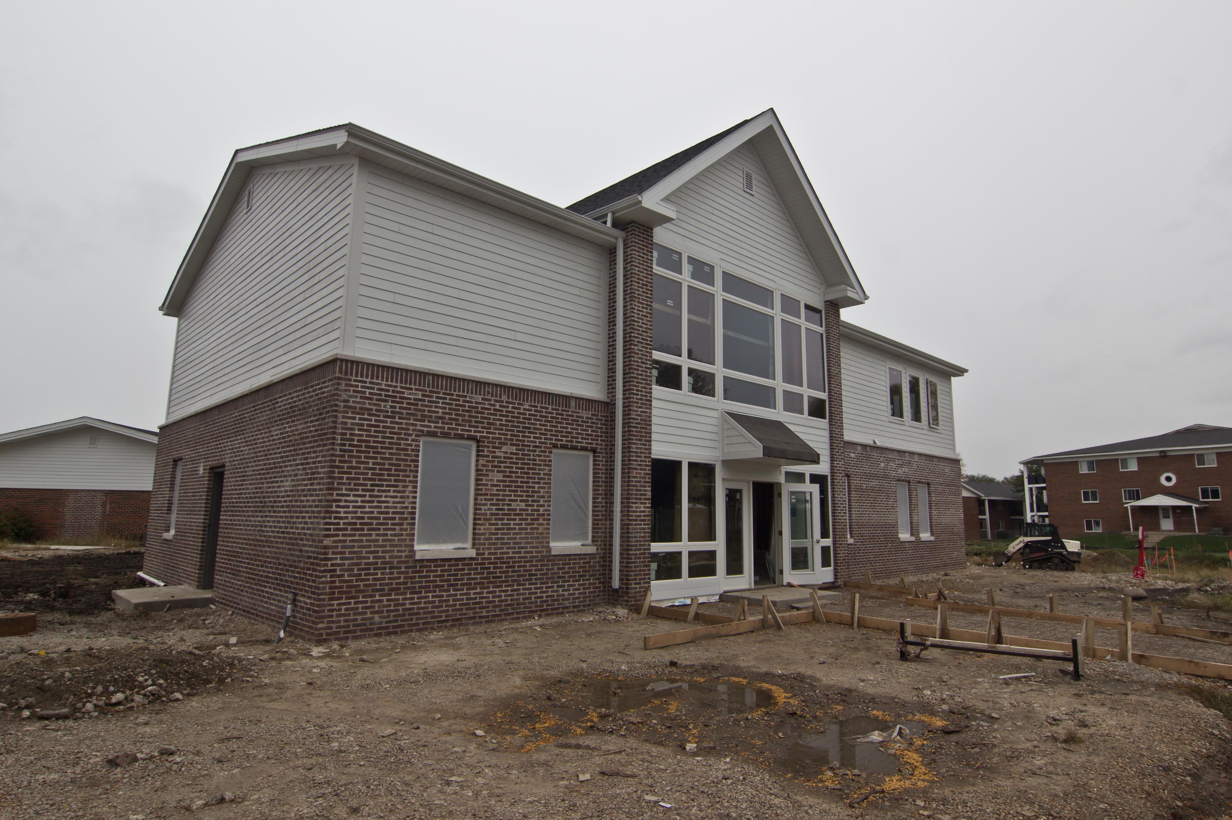

Slide 9
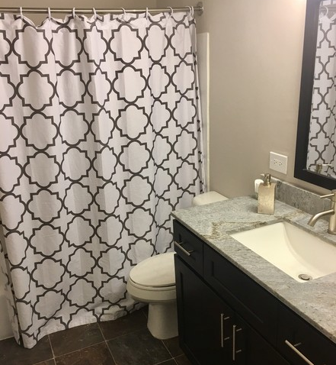
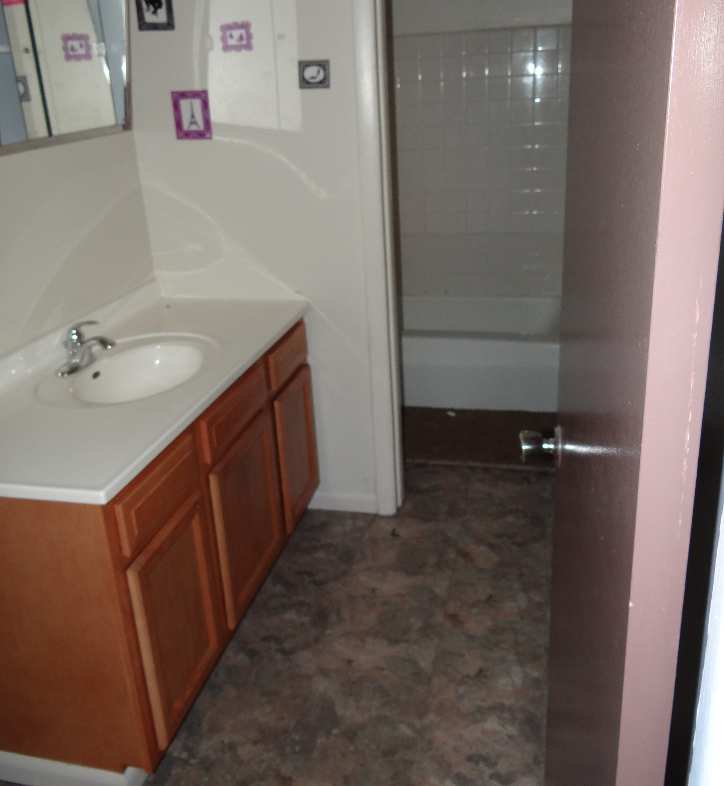
Classic Apartment Home
Quartz Renovation

Slide 10
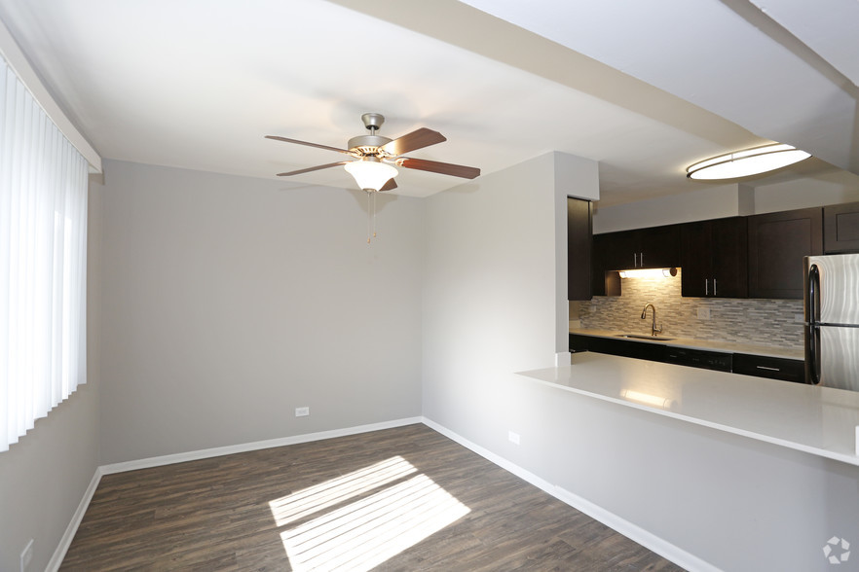
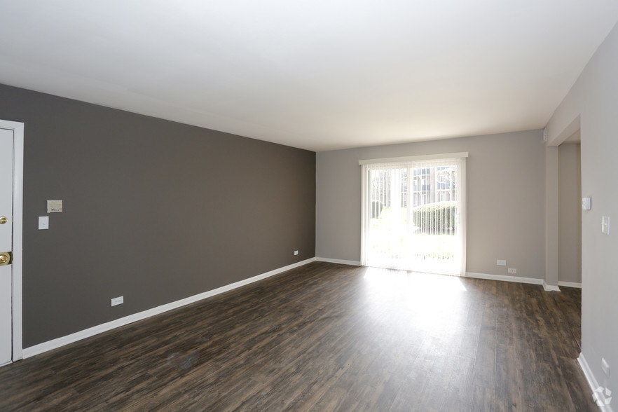
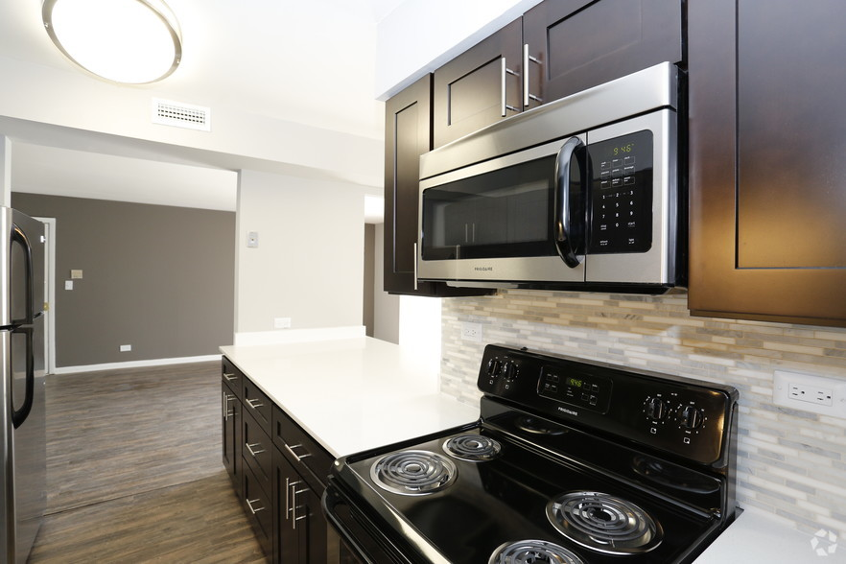
Photos of Renovated Apartment

Slide 11
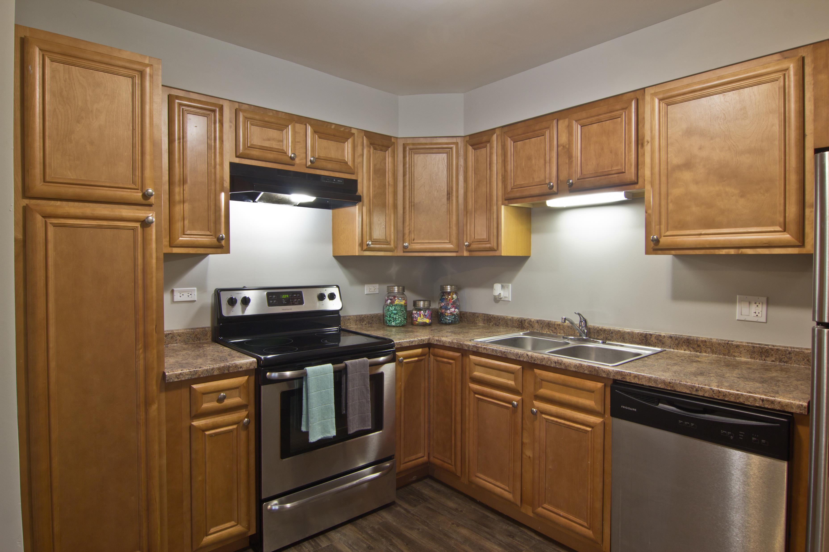
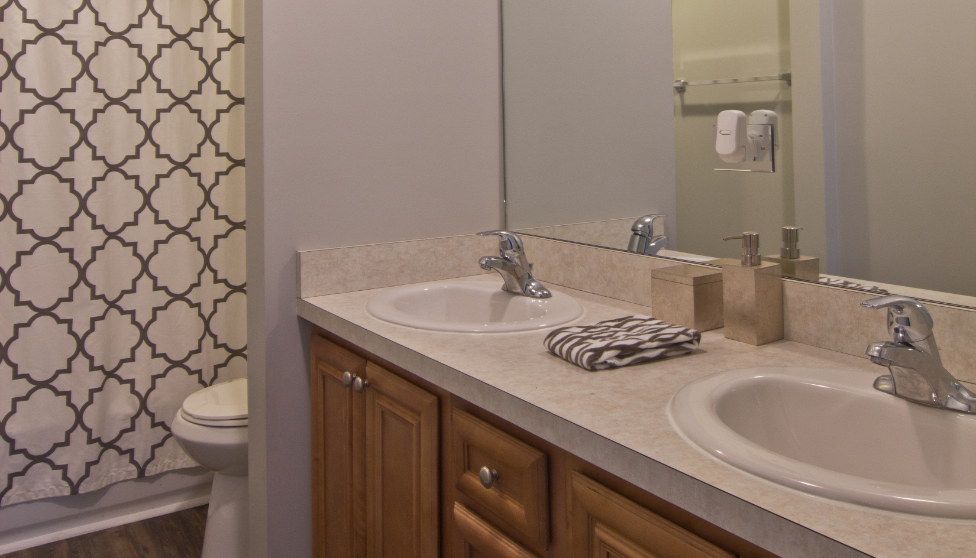
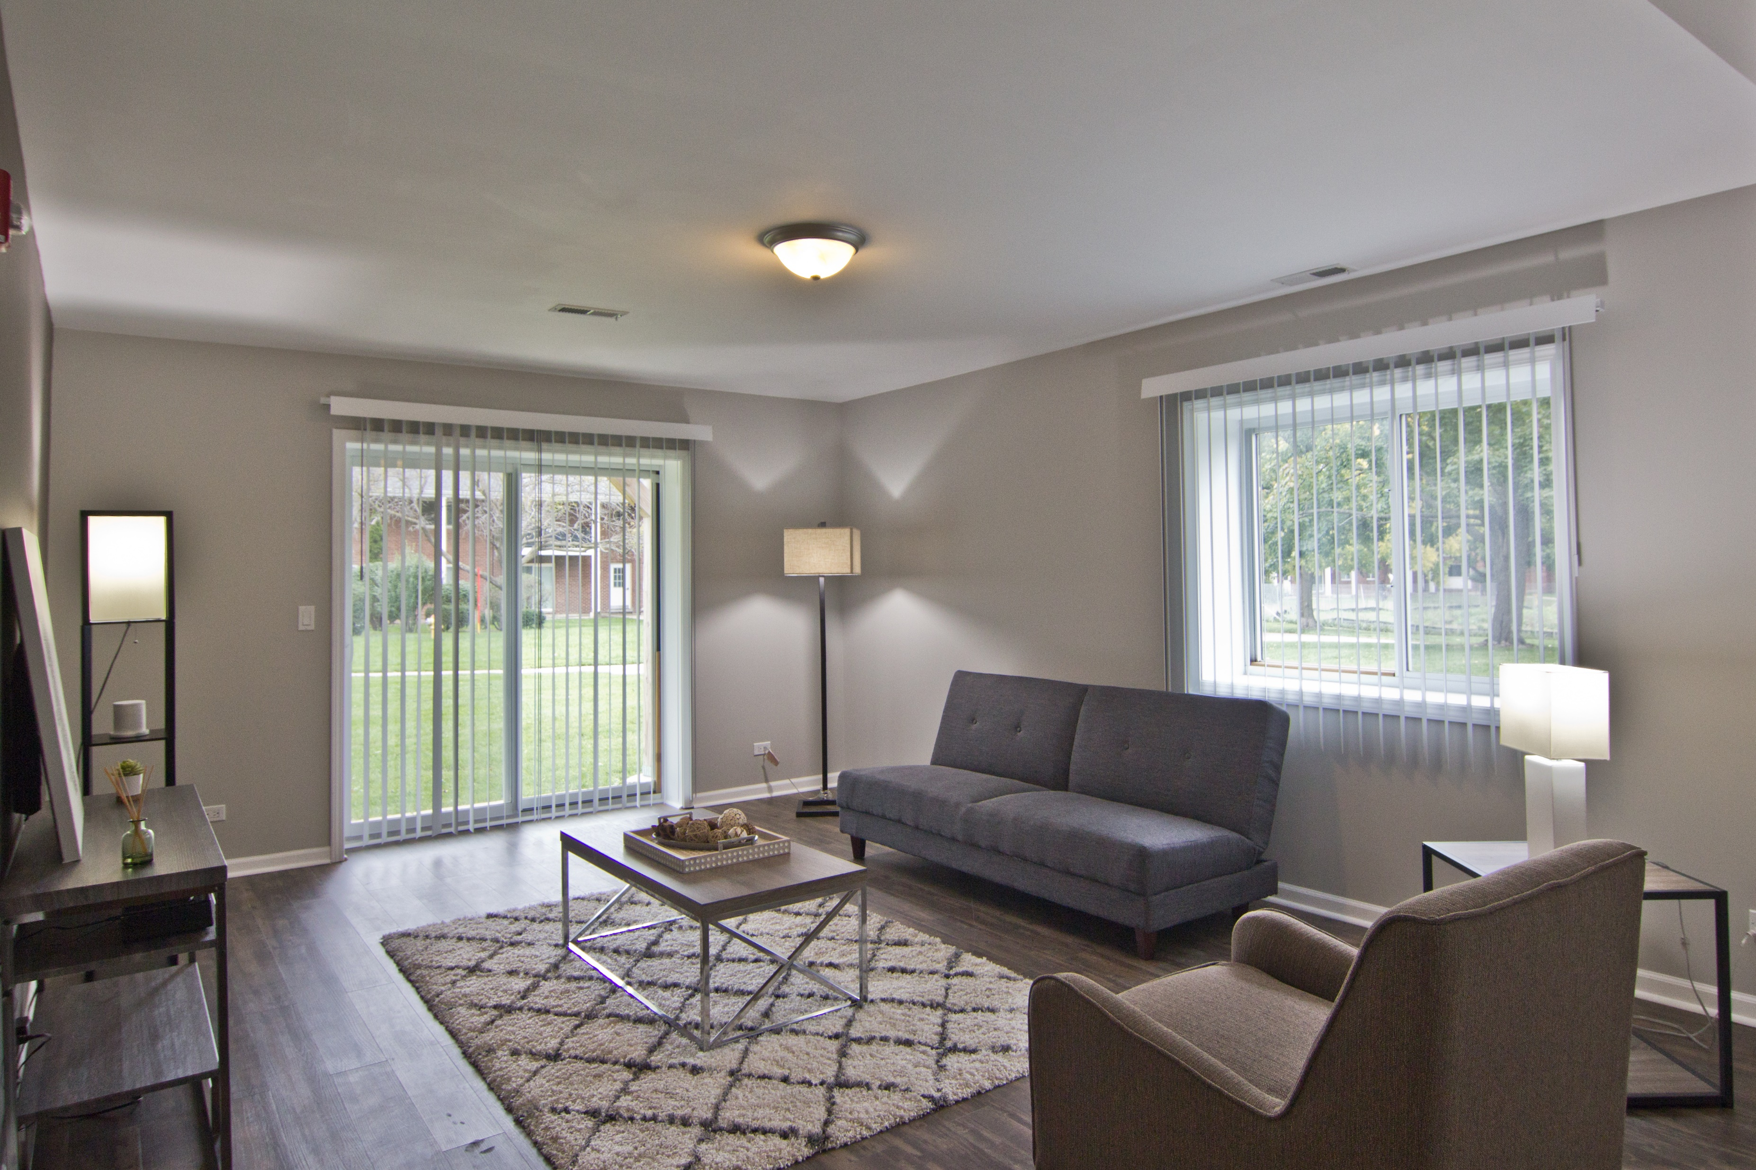
Unit Interiors

Slide 12
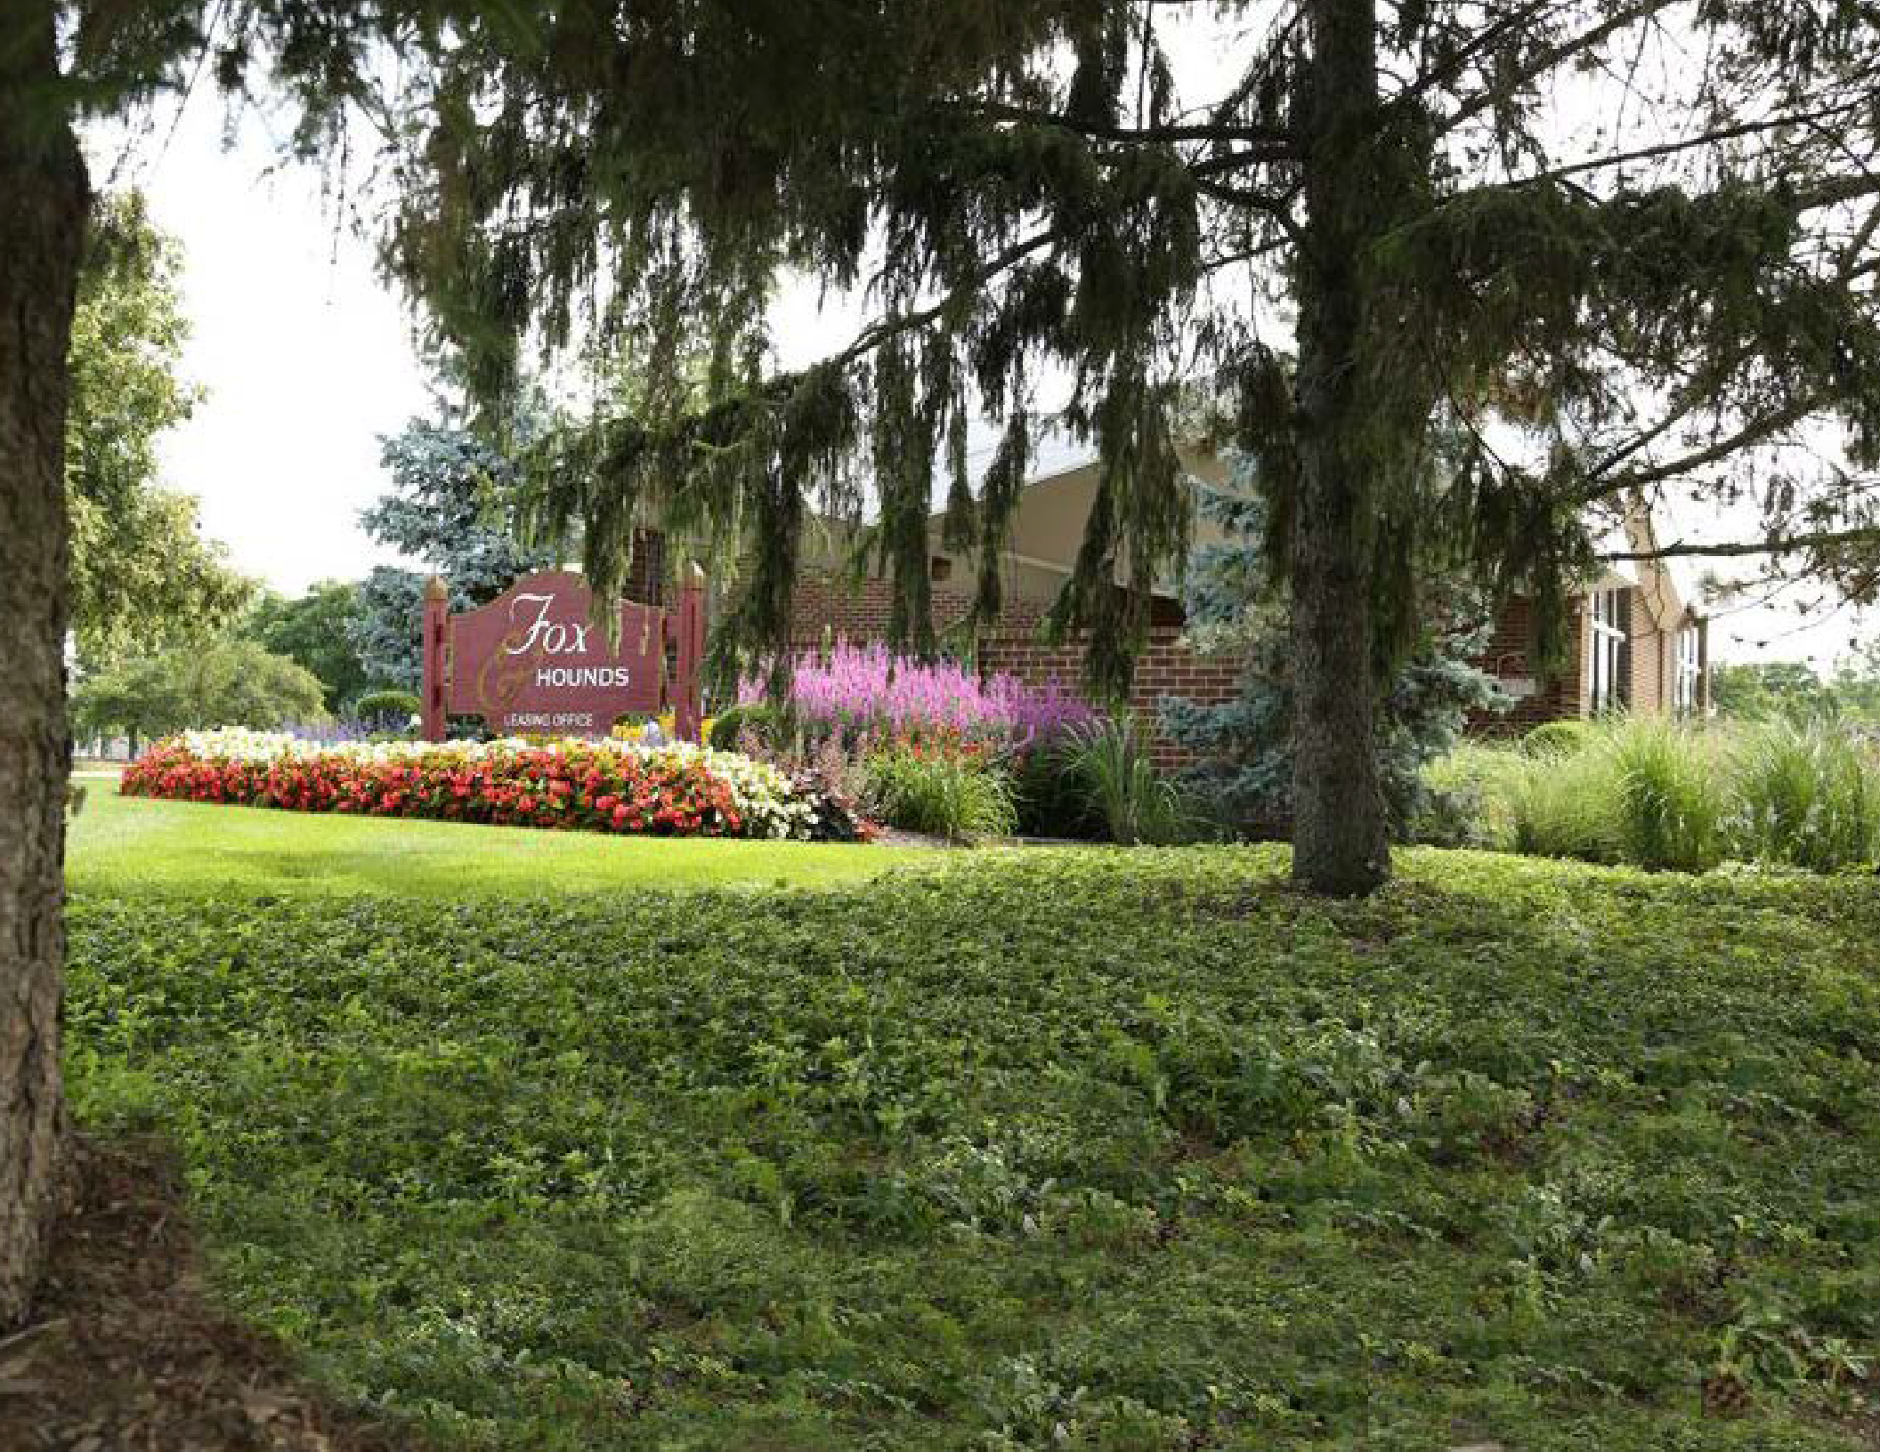
FRIENDLY HOMES APARTMENTS| 402 UNITS | COLUMBUS, OHIO

Slide 13
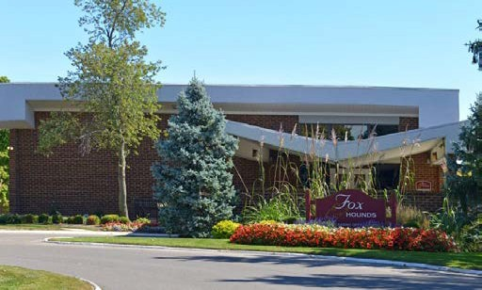
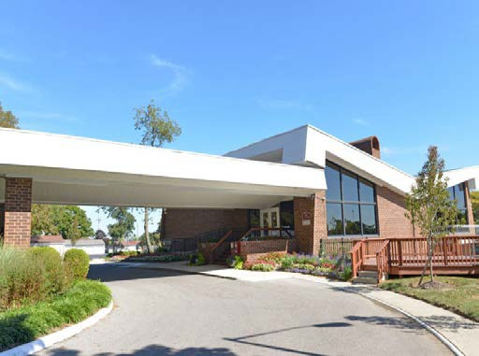
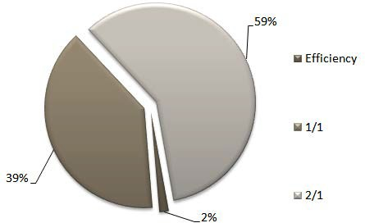
Property Overview
Number of units | 402
Year of construction | 1972
Rentable SF | 309,702
Average unit size | 770 SF
Rent per unit | $806
Rent per SF | $1.05
Occupancy Unit Mix | 98.3%
Type | Units | % Type | Unit sf | Leased/ effective rent | Rent / sf | Total sf | Total rent
Efficiency | 6 | 1.49% | 387 | $651 | $1.68 | 2,322 | $3,906
1 bed/1 bath | 158 | 39.30% | 650 | $751 | $1.16 | 102,700 | $118,658
2 bed/1 bath | 238 | 59.20% | 860 | $846 | $0.98 | 204,680 | $201,348
 | 402 | 100% | 770 | $806 | $1.05 | 309,702 | $323,912
Unit Mix by floorplan

Slide 14

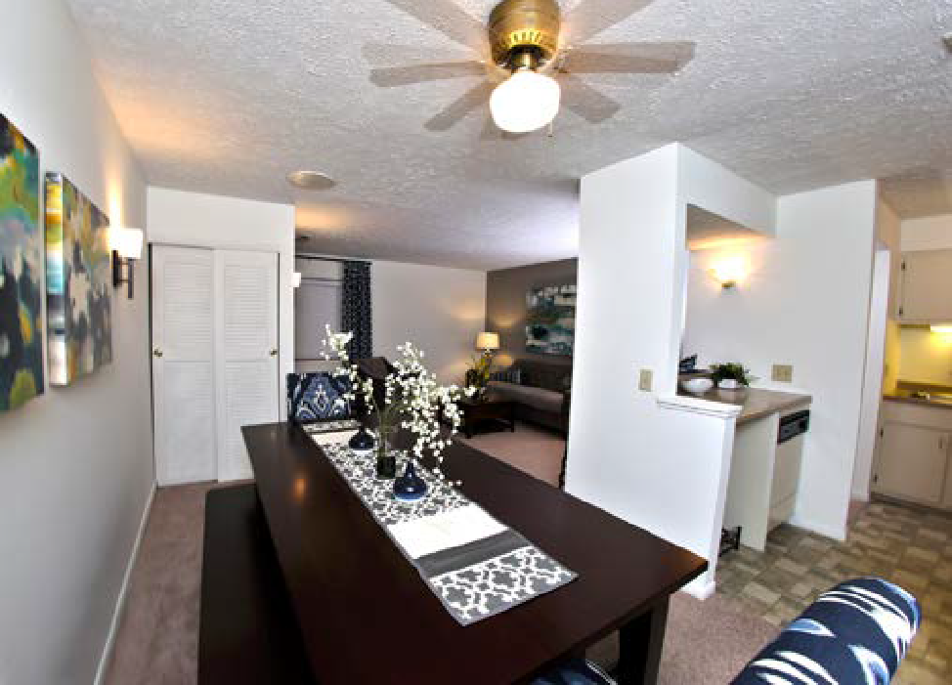
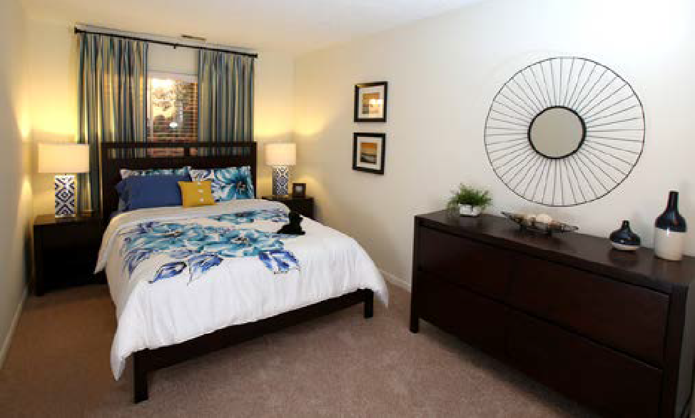
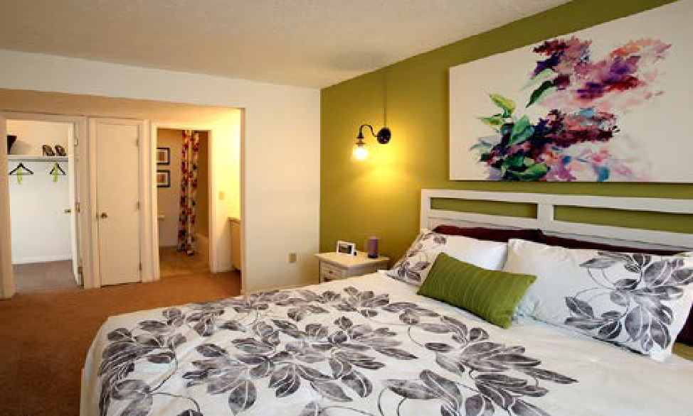

Slide 15
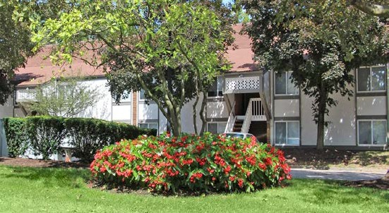
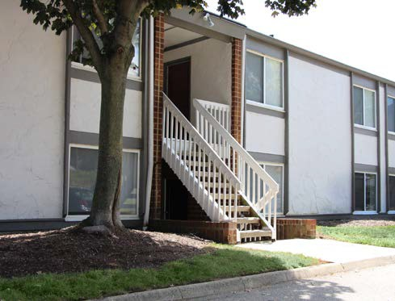
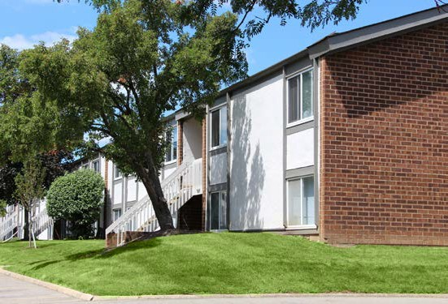
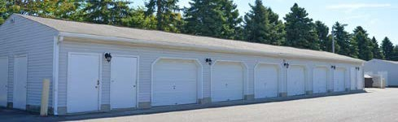
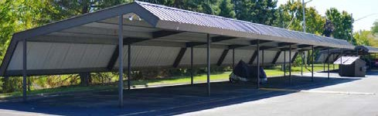
13

